Slide 1

Quantum Collective
The University of Texas at Austin

Slide 2
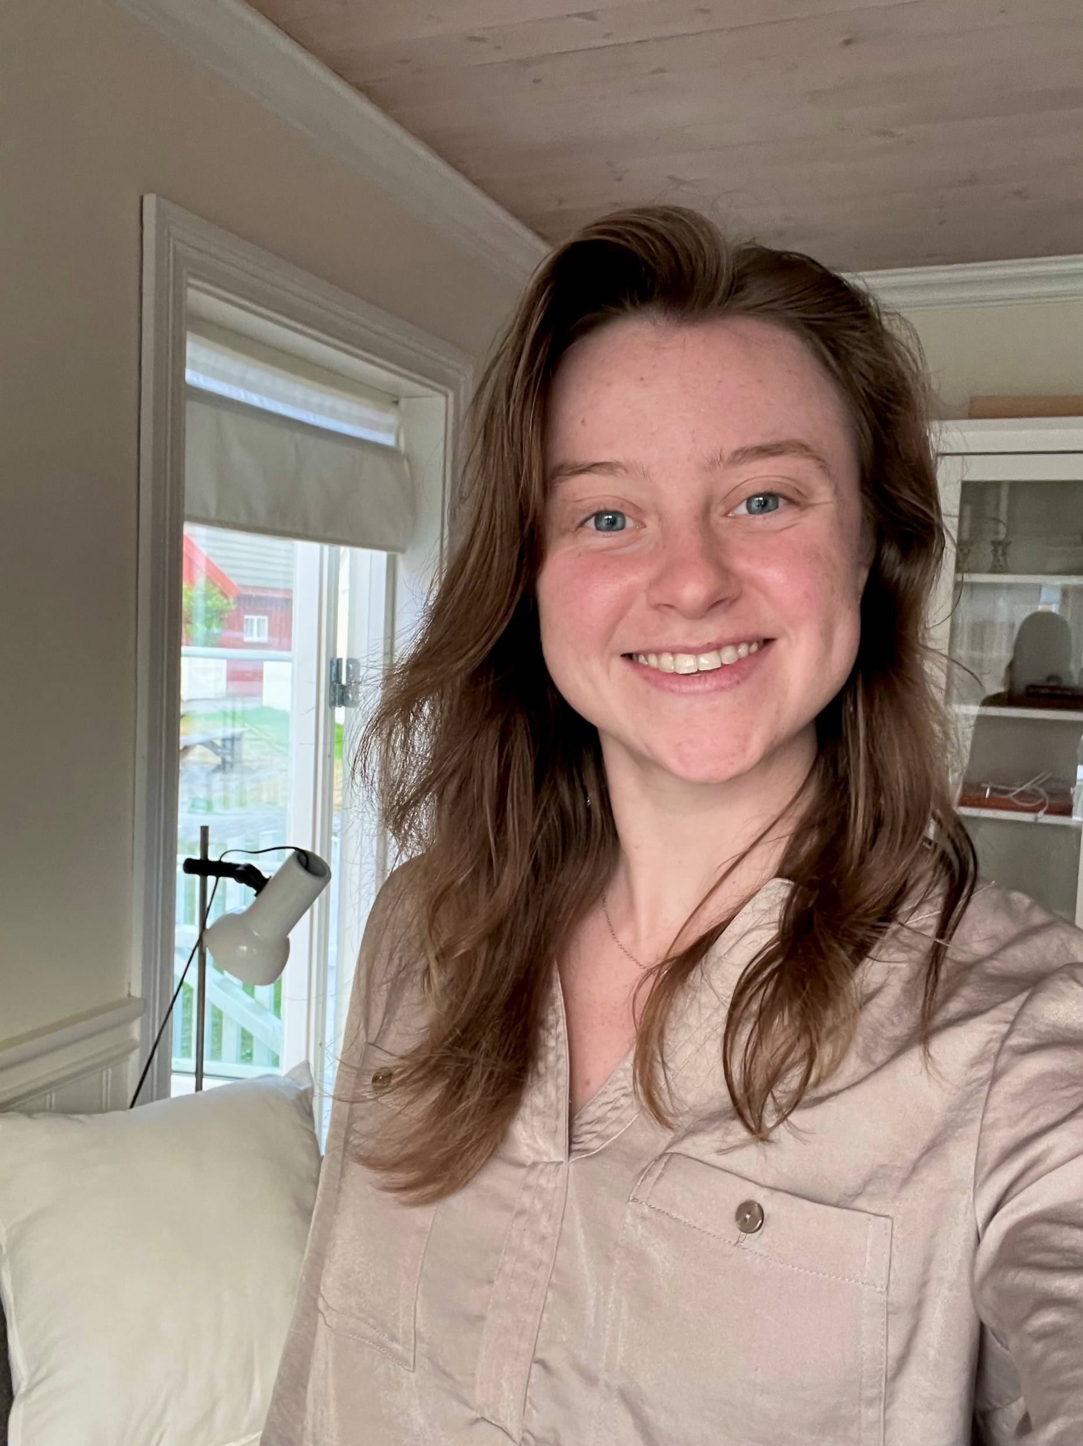
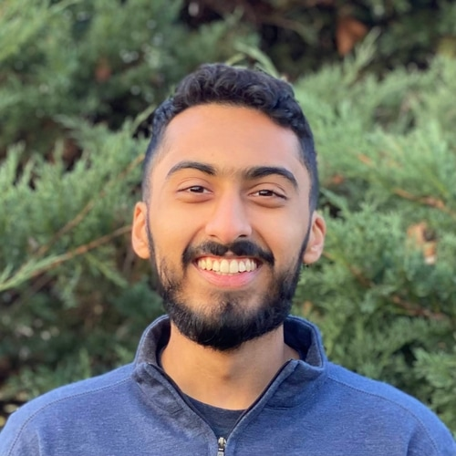
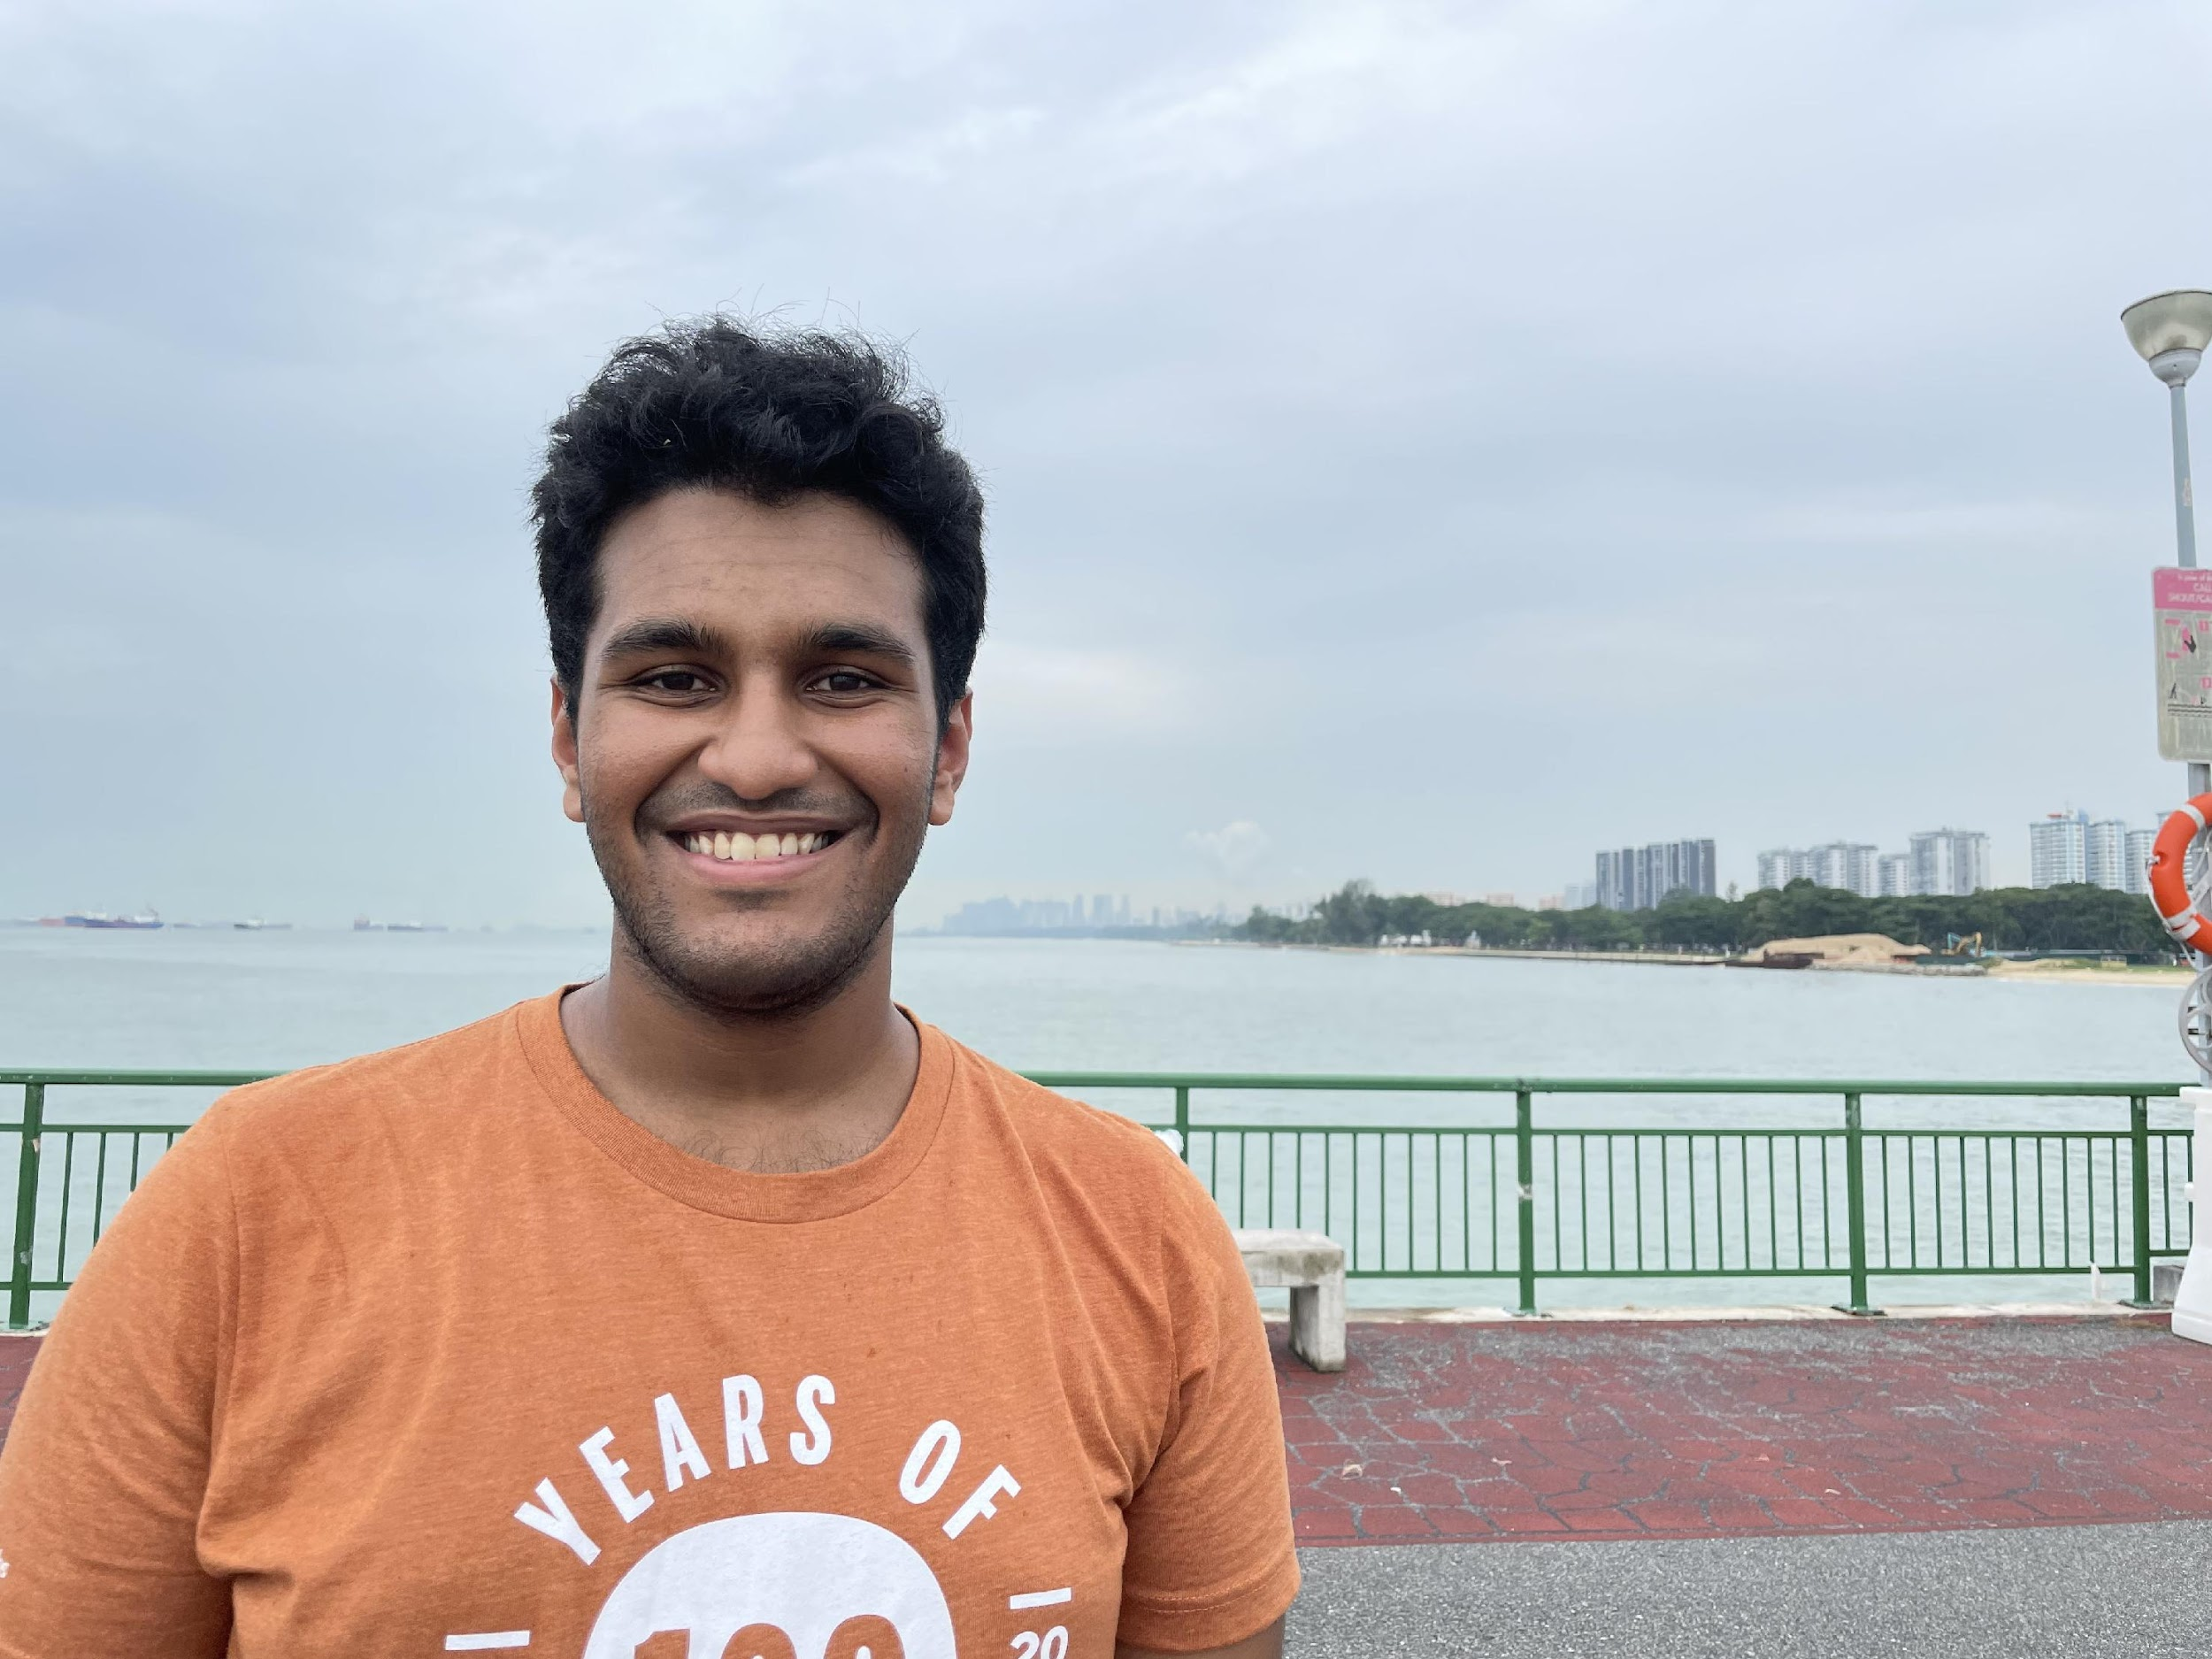
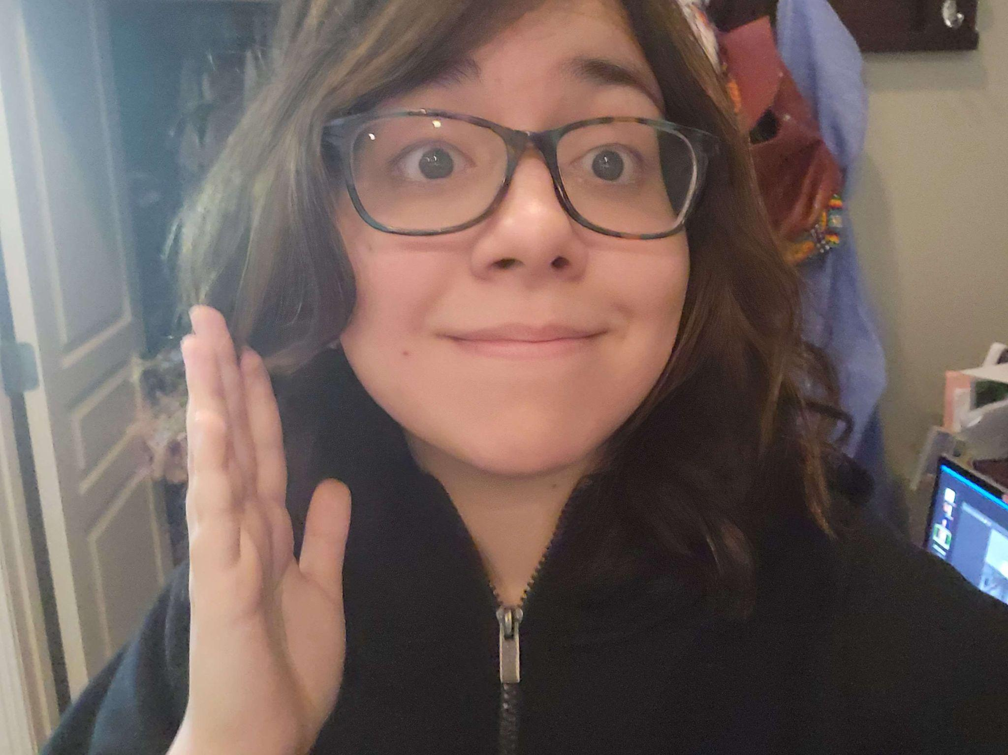
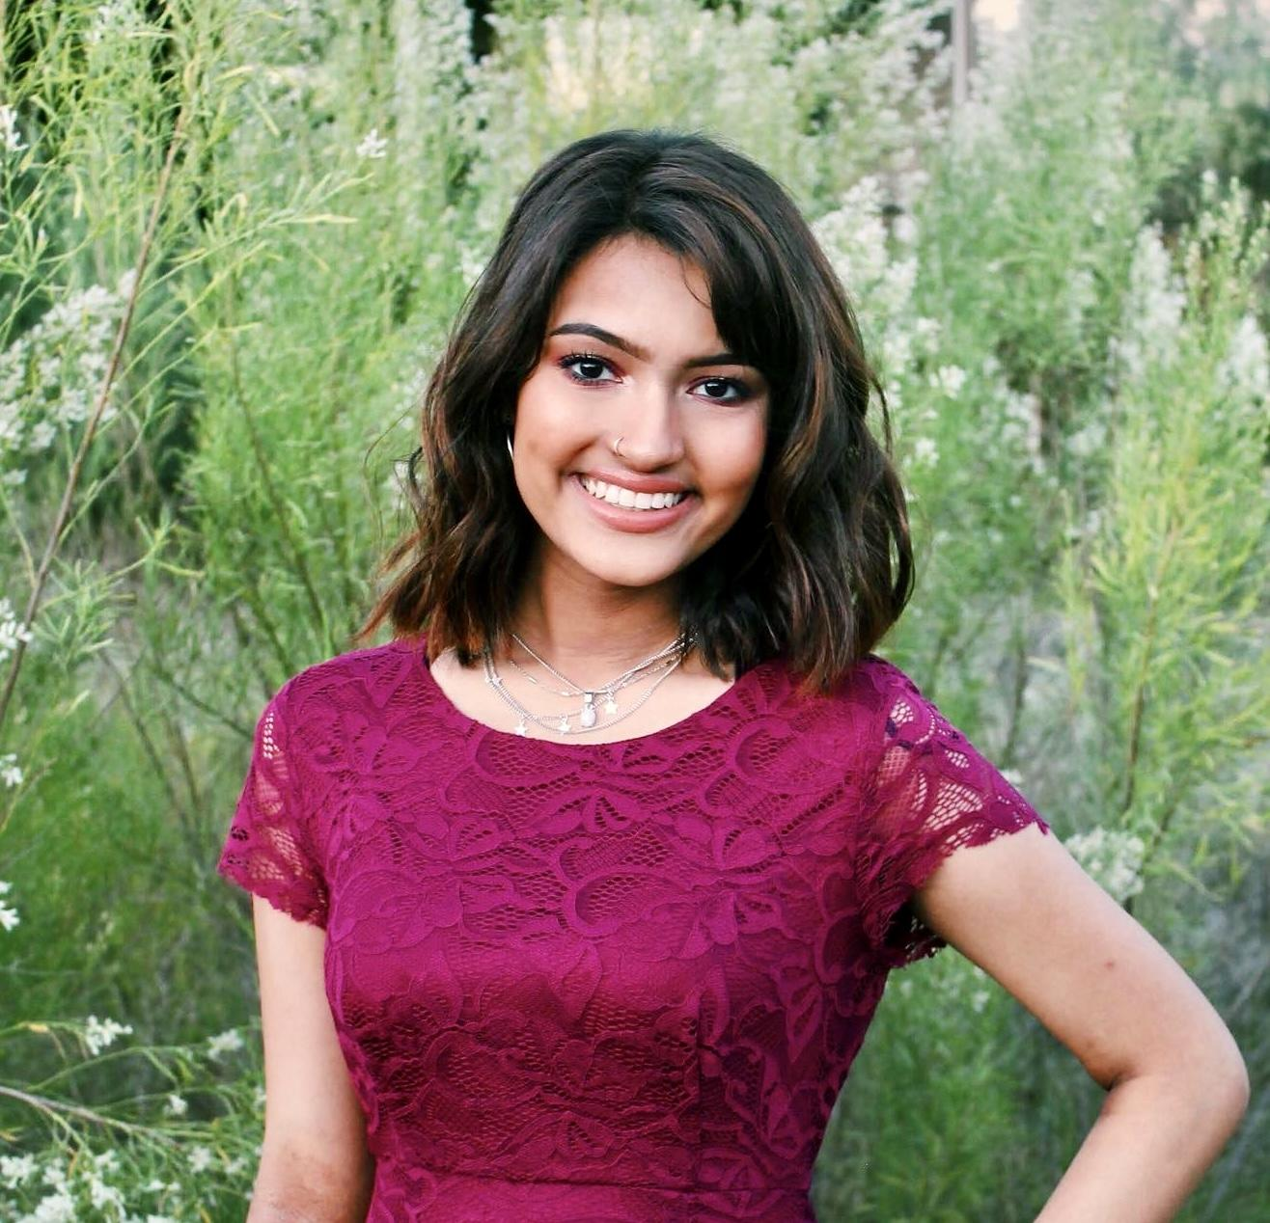
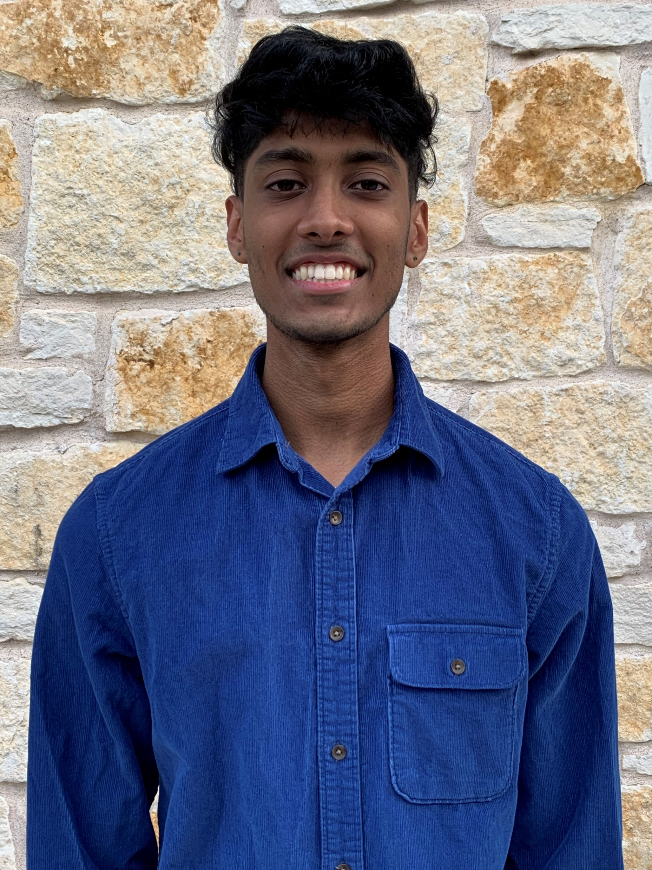
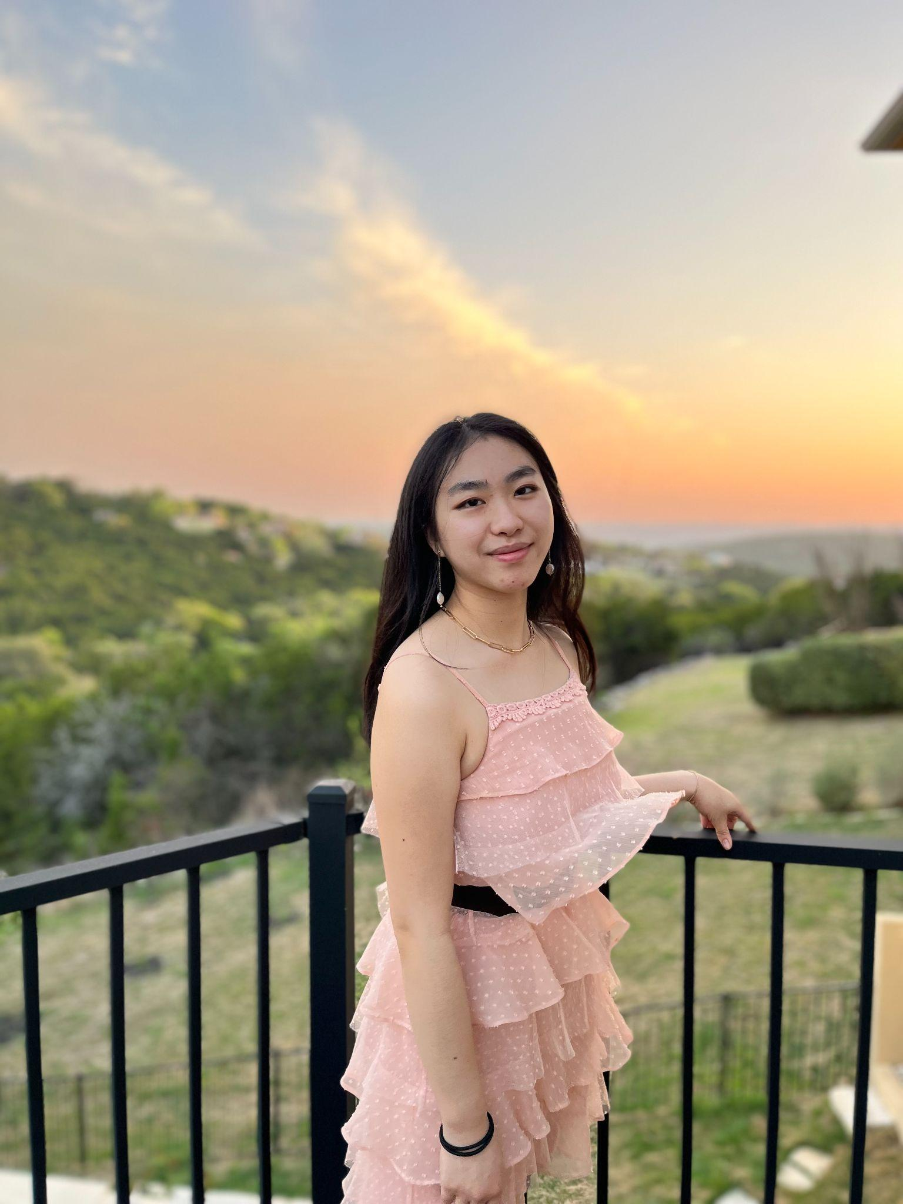
Officers
Michelle Gelman
Ronak Ramachandran
Adittya Patil
Emily Padilla
President
Dirac-tor of Research
Dirac-tor of Learning
Dirac-tor of Reading
Sneha Kamal
Sarvesh Raghuraman
Estella Zhao
Rithvik Reddy
Dirac-tor of Publicity
Dirac-tor of Finance
Dirac-tor of Events
Dirac-tor of Research

Slide 3
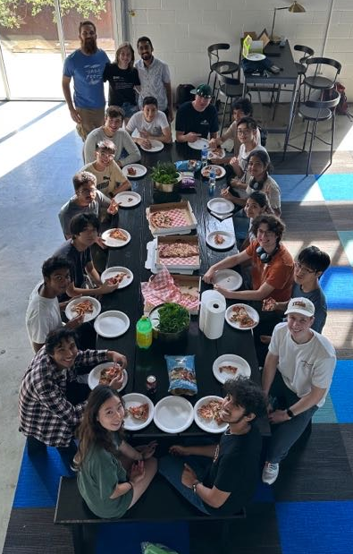
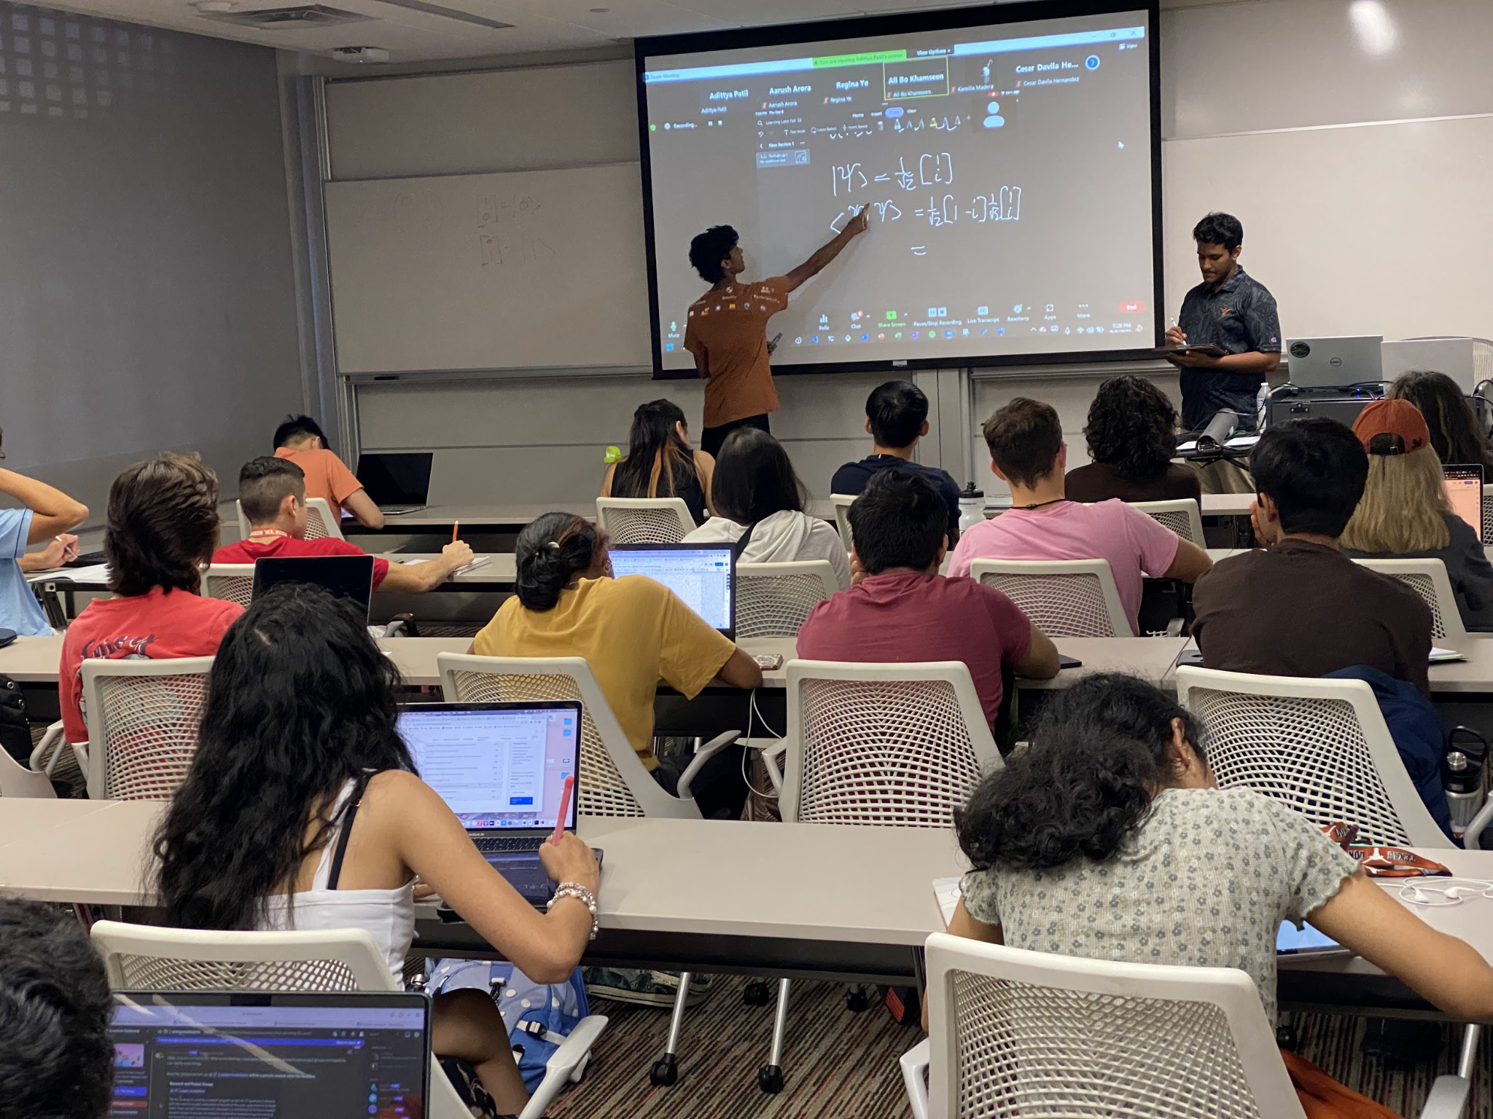
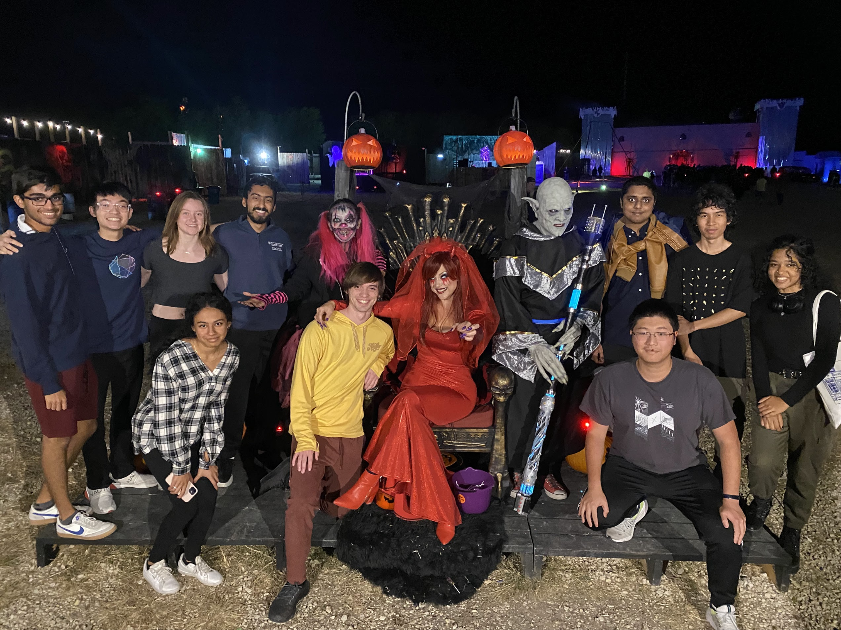
Overview
Regular Events
Reading Groups (weekly)
Learning Labs (every week)
Research Project Meetings (weekly)
Cat-Box Socials (monthly)
Special Events
SQUID Conference (end of semester)
Guest Speaker Events (varies)
Notes:
Overview slide

Slide 4

Learning Labs
Adittya Patil
Sarvesh Raghuraman
“How can I program a Quantum Computer?”
Thursdays
7:00-8:00pm
GDC 6.202
every other week (Starting Jan 26)
“How can I certify my skills?”
Learn to Program a Quantum Computer with Qiskit
Getting an IBM Quantum Developer Certification

Slide 5
Our Big Goal This Semester
Building a stronger community!
Reading Groups, Learning Labs, SQUID
Increase opportunities for social events

Slide 6

SQUID Mock Research Conference
Symposium of Quantum Undergraduate Inquiry and Discovery
The S.Q.U.I.D. conference is the first-ever global quantum research conference for undergraduates — by undergraduates. Together with other Quantum student organizations around the world, join us for a weekend of project presentations, panel sessions, and networking events.
Michelle Gelman

Slide 7


The first steps
Starting the Journey
A cursory google search
Accessing Google Scholar or arXiv.org is a great first step to access research papers
What is arXiv again? It’s an open-access archive for articles in a broad range of fields – physics, mathematics, computer science, statistics etc.
However, arXiv is not peer-reviewed though in my estimation, if used with some caution, is still very useful!

Slide 8


dl.acm.org, Semantic Scholar, dblp
Starting the Journey
Some of these are focused on CS research like ACM, dblp but within these bounds, they are brilliant databases with more advanced search capabilities than arXiv or Google Scholar.
Not everyone lists their articles on arXiv which might be almost universal today but not exactly true years ago.
Semantic Scholar has a far broader scope than just CS. It is my favorite regardless on the field.
Unlike arXiV, these give you published papers with some very important markers about the research..see next slide

Slide 9
Important Quantitative/Qualitative markers
Best to approach some of these markers with some caution depending on one’s field of interest.
The key markers for a ‘cursory judgement’
Citations: how many does it have or any at all?
Published? CS research is often published in various conferences, a strange exception within the sciences…
Citations will yield a rough check on whether the research is baseline-legit or even somewhat influential to a degree.
Semantic Scholar has a brilliant AI-powered engine that shows related research along with #citations, referenced papers, # ‘ influential citations’.

Slide 10
Correspondence with professors
This is a very important if you’re particularly invested in a research topic
How does this work?
It’s simple… email professors or go to their office and ask them for help. It will spare a lot of the needless trouble that accompanies trying to scour the thousands of papers out there.
They can inform which papers are seminal papers, which serve as good introductions to a niche subfield, or which reveal groundbreaking techniques/ideas.
This is related to the idea of research as dually a piece of technical, thorough, organized writing with novel results and a social process that is hardly guaranteed to be steady and definite.

Slide 11
How do you actually ‘read a paper’?
Here is the most challenging part of the process
The well-known 3-step process broken into a few more steps
Read the abstract, summary very carefully. Authors are trained/incentivized to write brief but thorough abstract so you’re mostly in good luck.
Next, read the conclusions, glance and the headings, first few lines under each heading and all the pictures. The pictures are indispensable in quickly gauging what is being discussed.
Make another go at it but this time, dig into the details of the argument but not into every specific. For example, if there is a mathematical proof which uses a very clever but not too relevant trick using the Chebyshev inequality or something, it might be fine to ignore such things sometimes.
Continuing on….

Slide 12
How do you actually ‘read a paper’?
The Unyielding Optimization Conundrum?
What do I ignore vs What do I ‘read’? This takes experience gained from making such attempts in some field.
If one is just starting off in some field, I highly recommend taking some of the most important/seminal papers and reading them thoroughly(as in every single statement) before familiarizing yourself with usual methods.
Continuing on..(The Next Step)
Now, it is time to actively engage with the research material/text. This is perhaps the most challenging part of the process. And, what does it involve?
Active engagement with the paper/text; taking notes; intuition of the techniques used which also means ‘some prediction of the rest of the paper’
…..

Slide 13
How do you actually ‘read a paper’?
It is crucial that one differentiates this final step from merely reading a textbook as you’re used to doing in class.
ENGAGE!
You should have some idea why the results themselves are novel.
The goal is to re-imagine/re-contextualize the paper in your own world – to possess it, not know it ; to break it up into disparate parts, organically, from the very nature of reading the paper, and then commit to the harder task of rebuilding it yourself.
This takes a lot more time than the previous steps, but you know that you have passed it once you can identify the general structure of the paper, its key arguments(not all), and gauge the scope/limits/assumptions of the novel result the authors construct.
You should also be able to explain the research in your own words to another person.

Slide 14
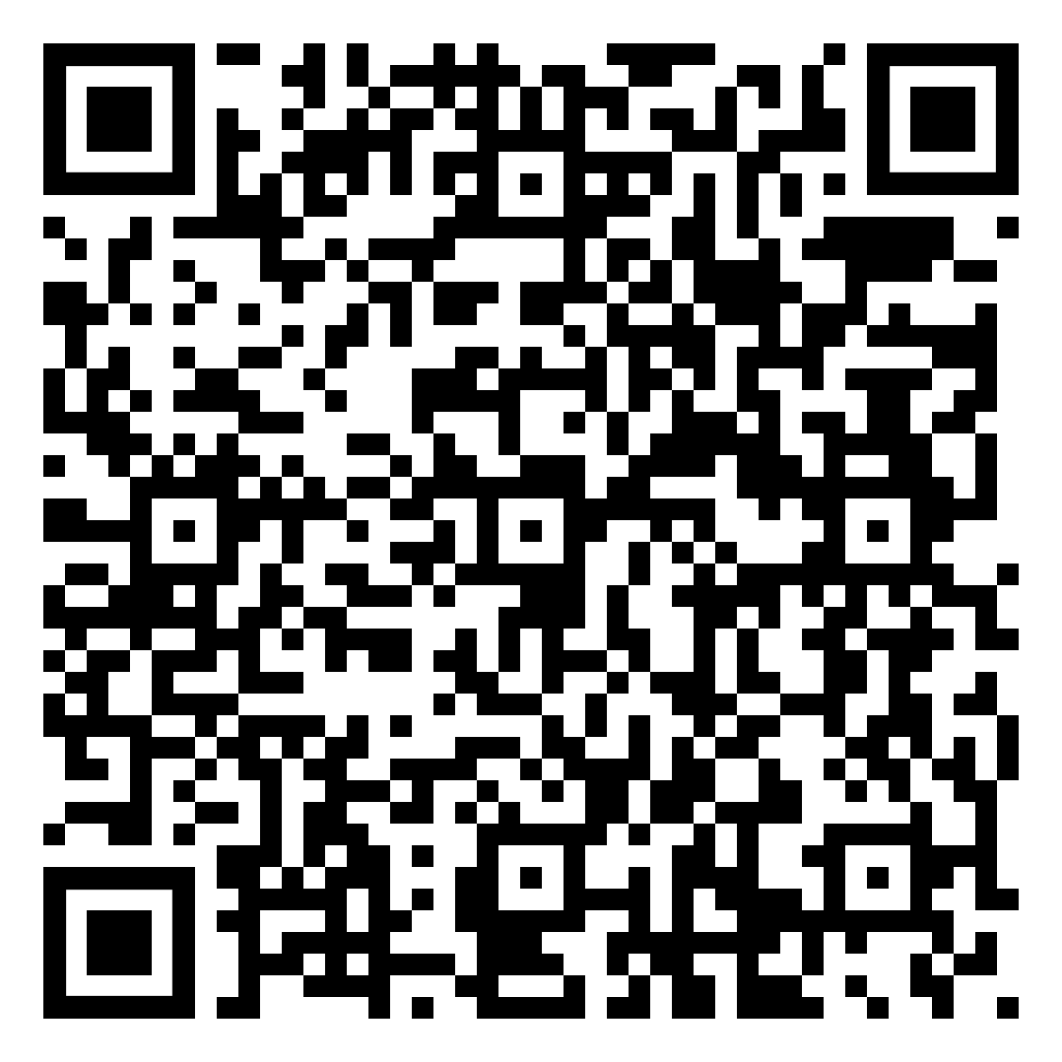
Announcements + Upcoming Events
STEM Girl Day Event (Women in STEM). Contact Estella on Discord for more information if you’re interested.
Tomorrow : First Learning Lab meeting on Jan 26th!

Slide 15





Social Media
Instagram
Discord
Website
YouTube
Twitter
Newsletter
(New!)

Slide 16
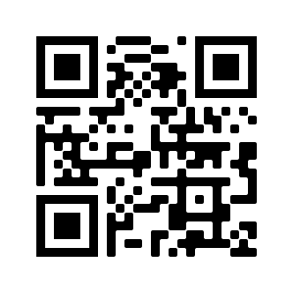
Discord!
THANK Y’ALL! :)

